Slide 1
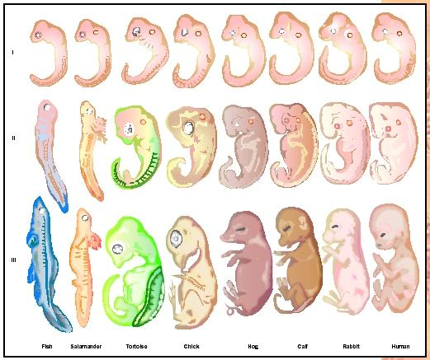
Animal Development I
Or: How do you get from a single cell to a complete, complex, fully functional, independent, multicellular, heterotrophic organism with only DNA as a guide?

Slide 2
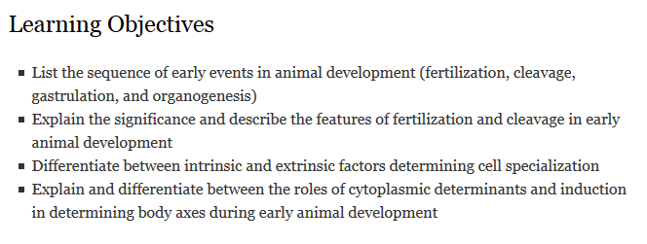

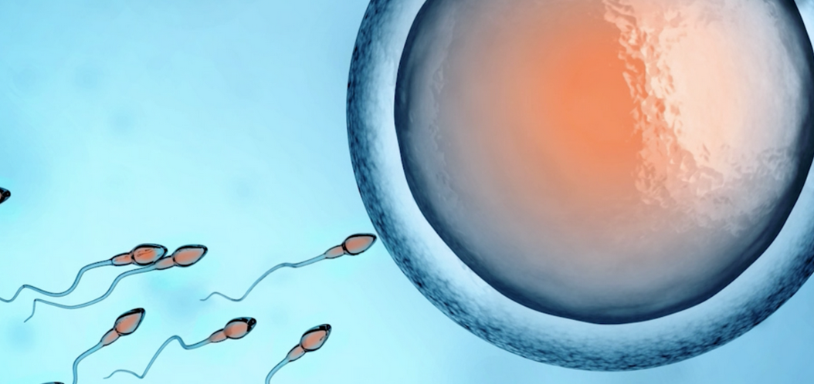
?
=

Slide 3
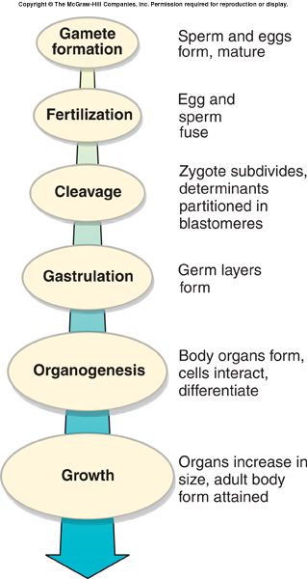
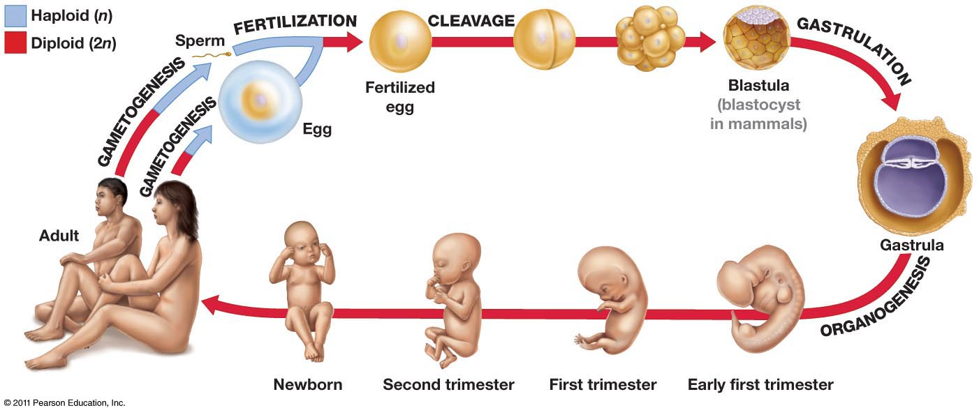
Four sequential stages:
  Fertilization
  Cleavage
  Gastrulation
  Organogenesis

Slide 4
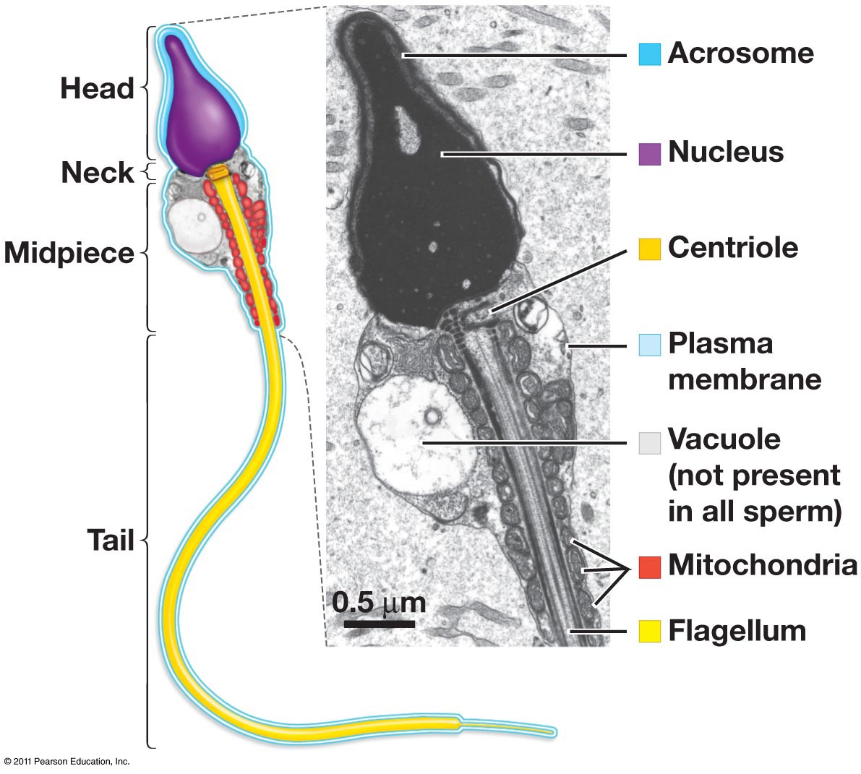
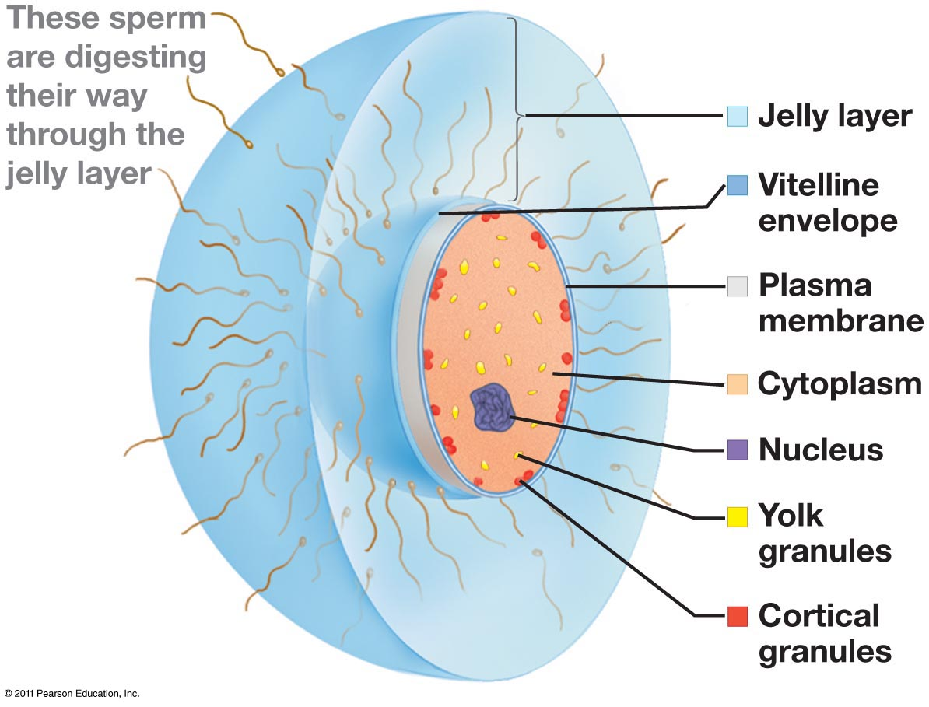
Sperm and Eggs
animals that lay eggs in water
zona pellucida in mammals
large mass in some animals

Slide 5
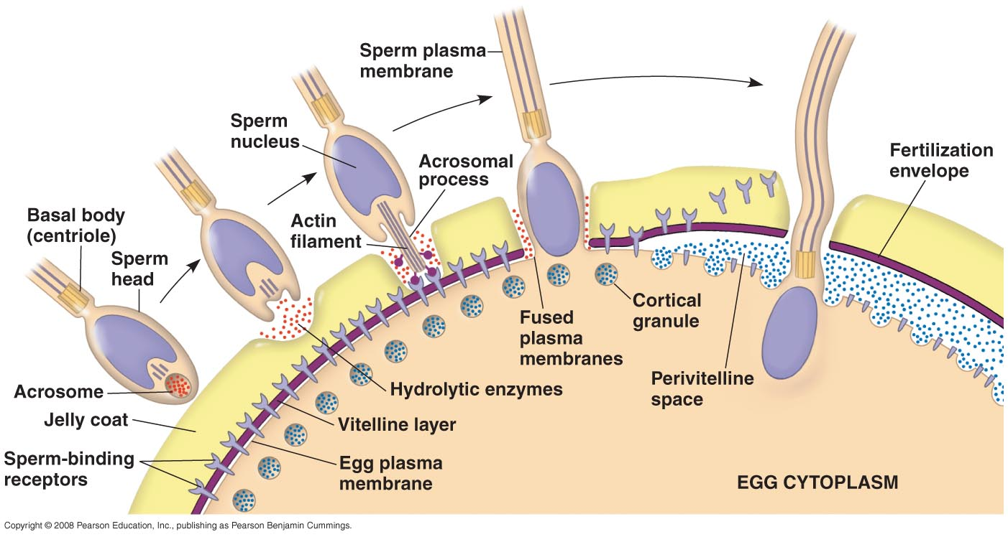
Events in Fertilization
Ca²⁺ wave also initiated by fusion
Which induces the cortical reaction
Which degrades the bindin receptors on the egg surface and causes the vitelline envelope to lift to form fertilization envelope (slow block)
Sperm binds to zona pellucida
Which initiates the acrosome reaction
Allowing sperm-egg membrane fusion
And causing egg membrane depolarization (fast block)
8. Egg activation
Notes:
Sperm binding (bindin on sperm interact with receptors in zona pellucida/jelly layer)
Acrosome reaction – digests ZP/jelly layer
Sperm-egg membrane fusion
Egg membrane depolarization (fast block to polyspermy)
Cortical reaction
Ca2+ wave induces fusion of cortical granules with egg plasma membrane
Released cortical granules digest sperm receptors
Vitelline layer lifts away from plasma membrane, creating fertilization envelope (slow block to polyspermy)
Egg is activated to initiate development

Slide 6
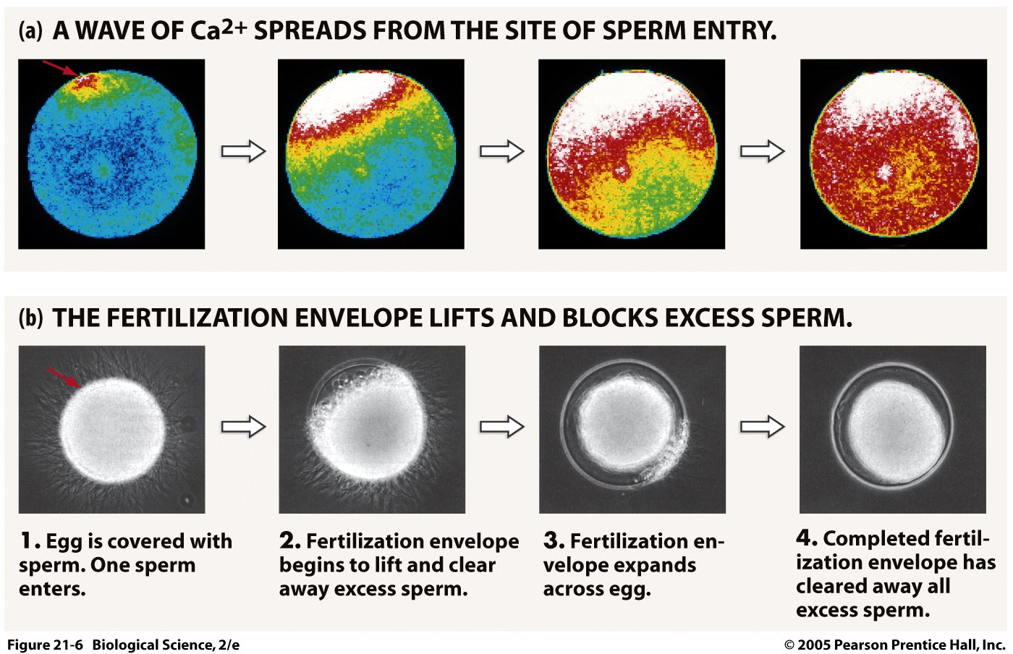
Calcium wave provokes the cortical reaction, which results in a) digestion of binding receptors on egg surface and b) formation of the fertilization envelope

Slide 7
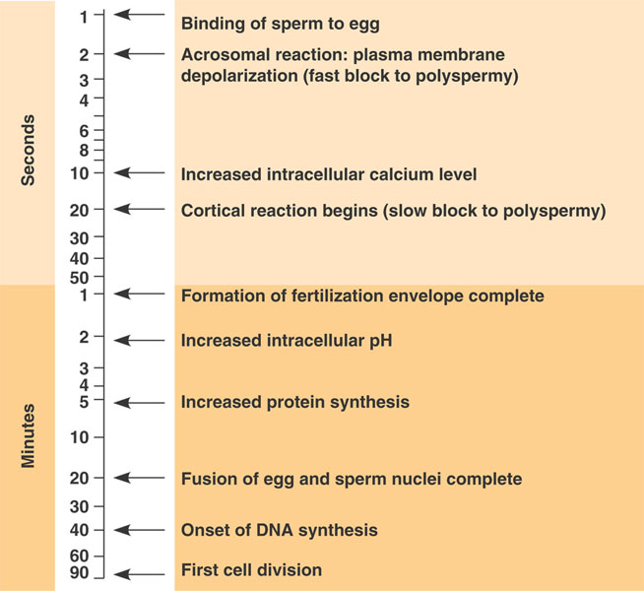
Timeline for sea urchin eggs
Figure 47.5, 7th ed. Campbell

Slide 8
Four sequential stages:
  Fertilization
  Cleavage
  Gastrulation
  Organogenesis

Slide 9
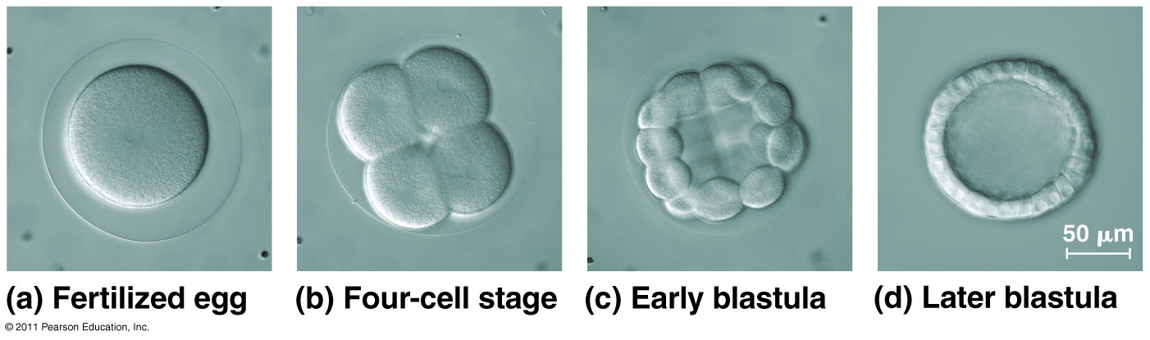
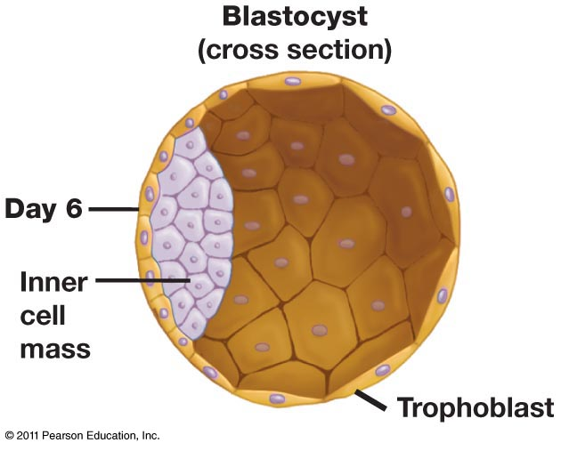
Cleavage
Cleavage results in
Mass of cells (blastomeres)
First tissue (blastoderm)
First cavity (blastocoel)
Establishment of body axes (this occurs at first cell division in protostomes and some deuterostomes; much later in other deuterostomes
Notes:
Hollow mass of cells
First tissue (collection of similar cells)
Blastoderm: progenitor of other tissue types
Blastocoel: first cavity

Slide 10
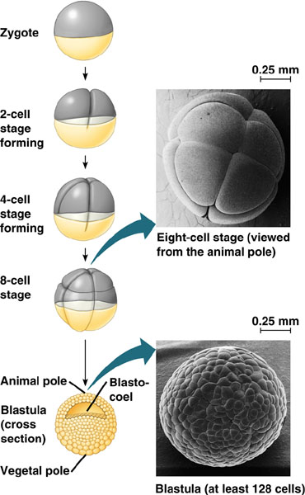
Establishing the blastocoel
Frog embryo
Sand dollar embryo
Why is the blastocoel significant?
Notes:
Note difference in size of blastocoel in frogs vs sand dollars

Slide 11
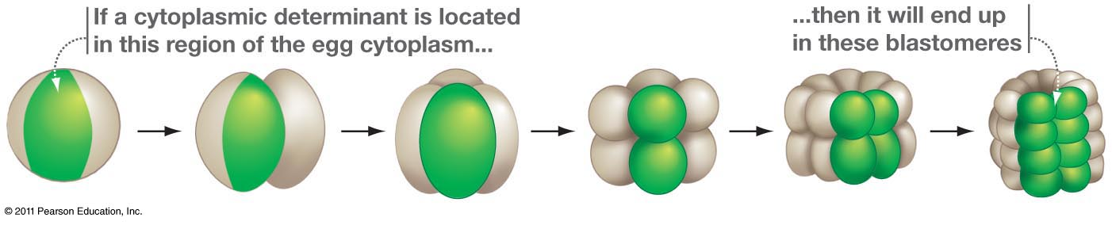
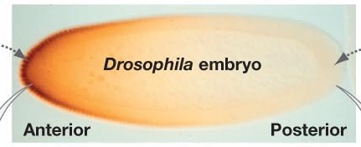
Establishing body axes:
cytoplasmic determinants
bicoid, nanos
Cytoplasmic determinants are a critical feature of protostome development, but not most deuterostomes. They are deposited in the egg by the mother, before fertilization.

Slide 12
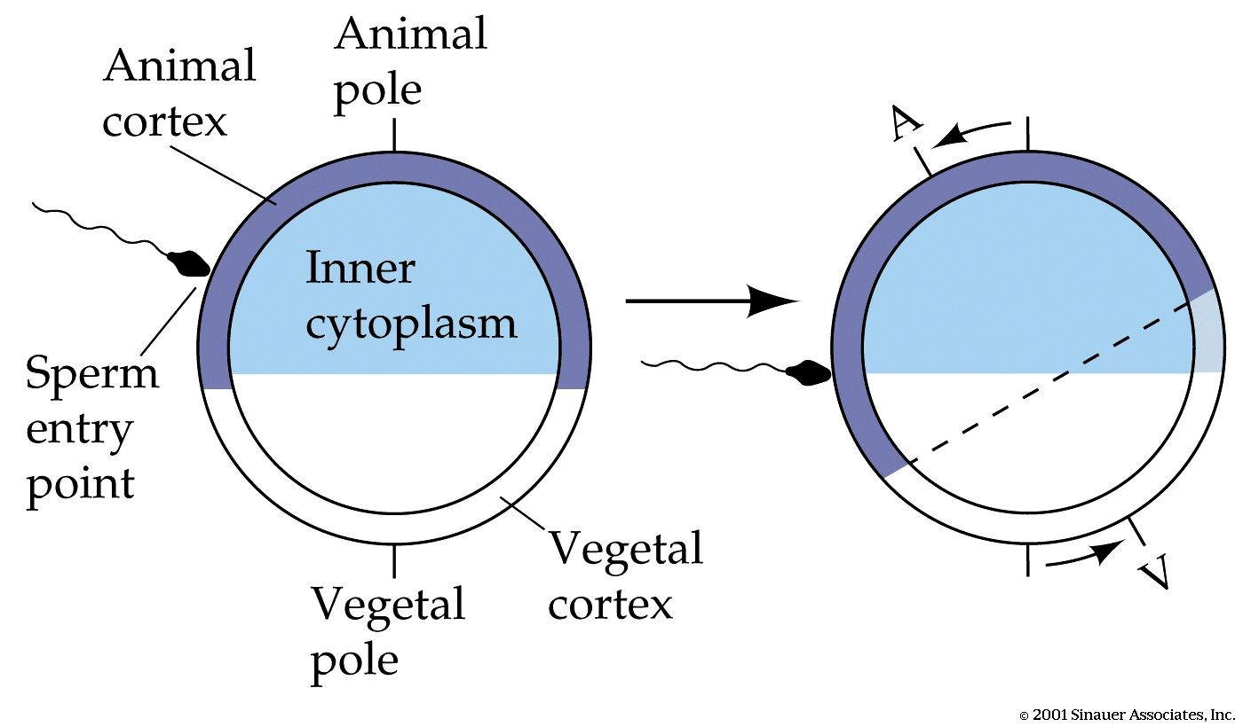
Fertilization “activates” the egg
Shift in cytoplasm creates grey crescent

Slide 13
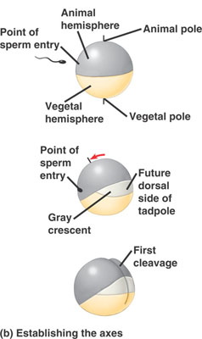
Establishing body axes: yolk polarity
anterior
posterior
Yolk polarity is a critical feature of development in deuterostomes with large amounts of asymmetrically distributed yolk
What about mammals?
ventral
dorsal
left
right

Slide 14
Establishing body axes: yolk polarity
anterior
posterior
Yolk polarity is a critical feature of development in deuterostomes with large amounts of asymmetrically distributed yolk
What about mammals?
No obvious polarity in mammal eggs as they contain minimal amounts of yolk
ventral
dorsal
left
right

Slide 15
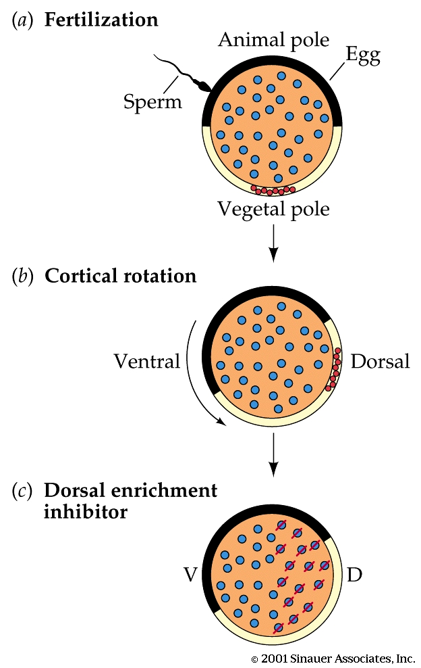
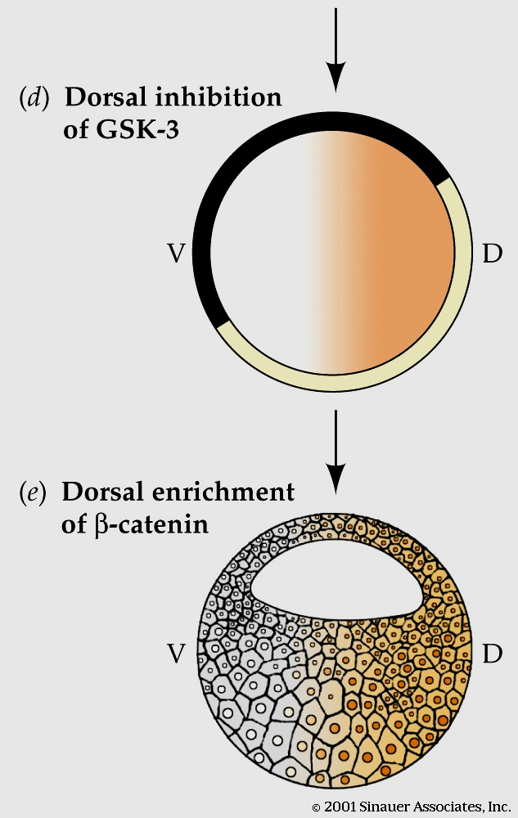
Dorsal-Ventral Axis Established Early
When the cortical cytoplasm shifts, it carries vesicles (red) that inhibit a protein (GSK-3) (blue) that targets β-catenin (orange) for destruction
The inhibitor is released into inner cytoplasm, & protects β-catenin, which will become the dorsal cells of the developing embryo

Slide 16
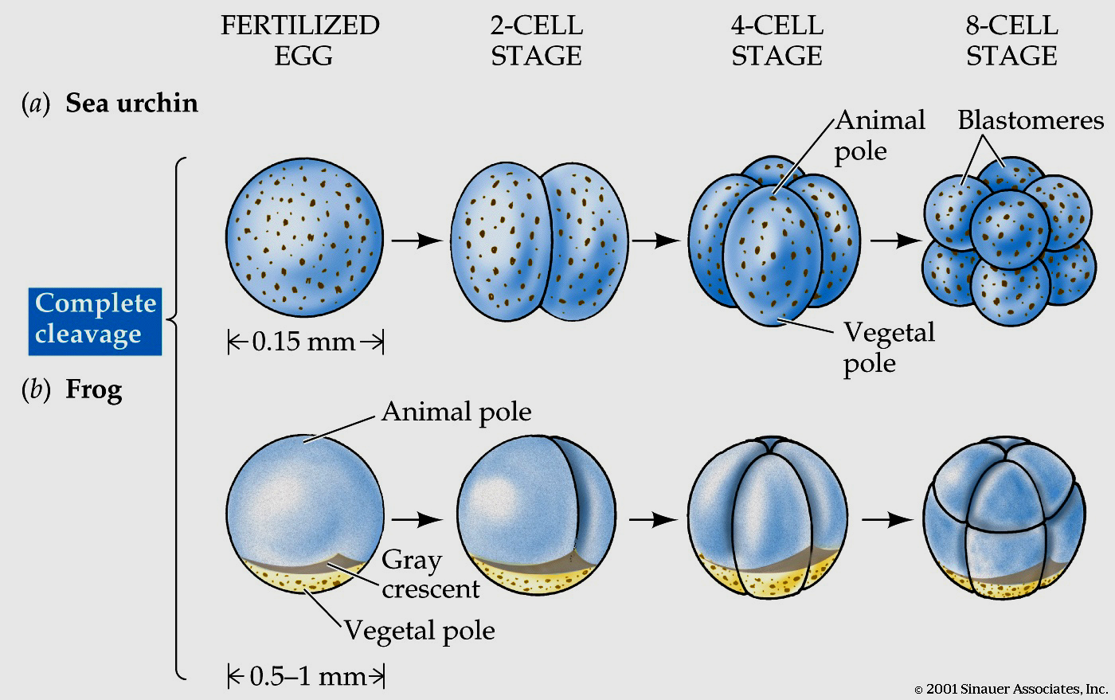
Yolk ‘lite’ vs ‘heavy’ eggs

Slide 17
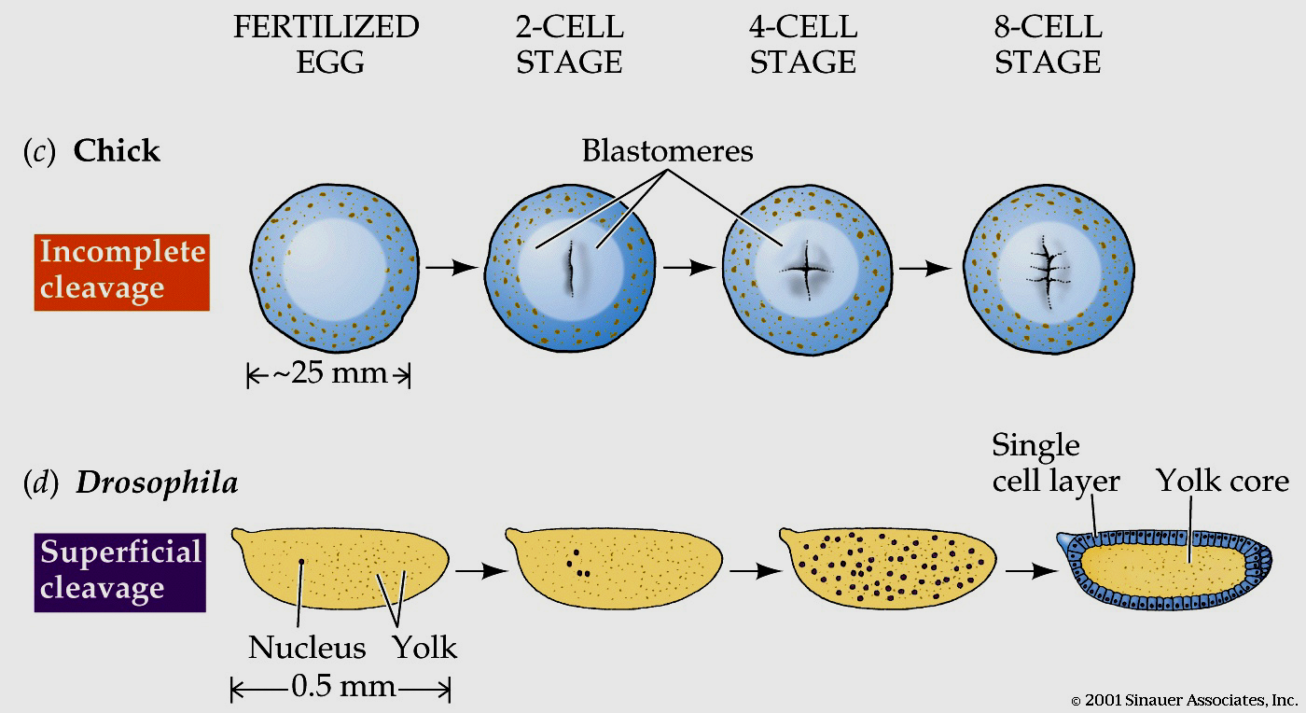
Very heavy yolky eggs: Problem?

